Slide 1
Project
Project on cars elite auto
Linkedin id
deepkanwargill3@gmail.com
Github id
deepkanwar3@gmail.com
Deepkanwar Singh Gill
Phone No. 9814076950

Slide 2
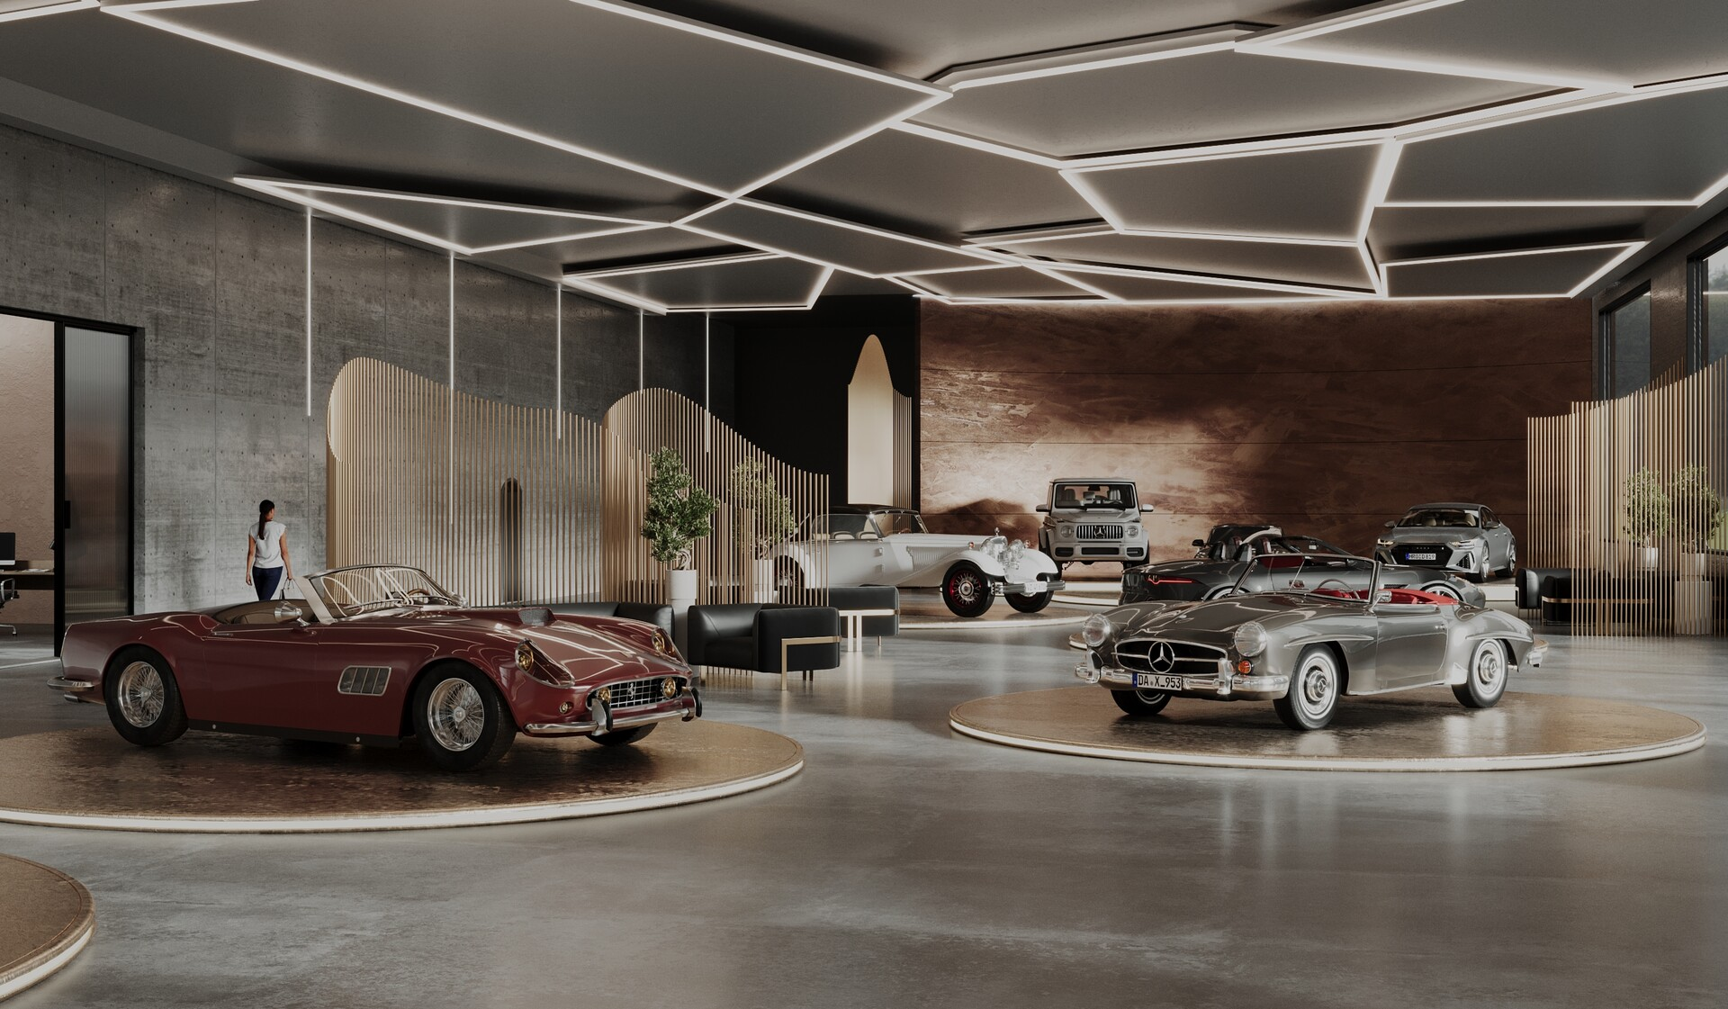
Elite Auto Gallery
Unleash the Exceptional. We are the Home of Foremost Luxury and High-Performance Automotives. (Focuses on the 'unleashing' of potential)

Slide 3
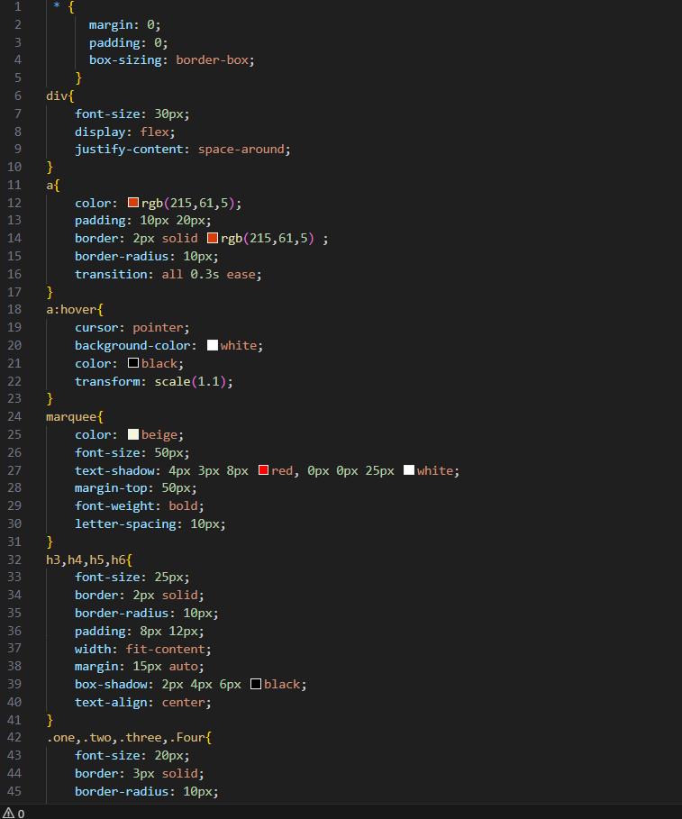
CSS Styling: Making It Visually Stunnings
Color Scheme
Typography
Use an elegant colour scheme featuring #7FB3E6 for primary elements, #22627A for text, and crisp whites for contrast, launching refined and professional visual gradings.
Use clear font sizes — 40px for headings and 20px for body text — and apply text-shadow effects finely to add emphasis and depth while maintaining readability.
Interactive Effects
Complement hover states with background color changes, scale transforms, and smooth 0.7-0.9s transitions. This keeps users promised and provides visual feedback.

Slide 4
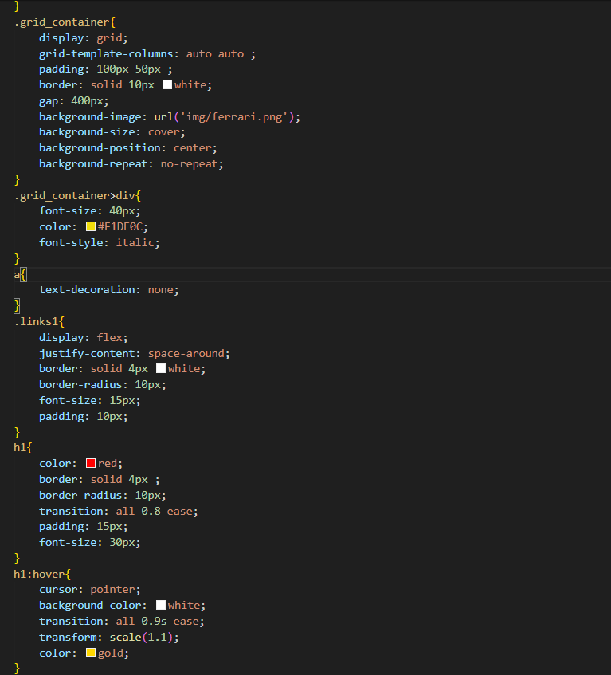
Advanced Features: Elevating Your Designs
1
Background Images
Apply background-size: cover and background-position: center to stage car images beautifully, ensuring they resize effortlessly on all devices.
2
Flexbox Layout
Use display: flex with justify-content: space-around to evenly deliver navigation items and ensure they adapt smoothly to various screen sizes.
3
Border Styling
Add rounded borders with border-radius: 10px and shadows with box-shadow to create modern, polished component edges.
4
Opacity & Transitions
Use a semi-transparent (0.9 opacity) intersection to layer content elegantly over backgrounds, and implement CSS transitions for smooth, professional, and responsive state changes.

Slide 5

Why Choose Elite Auto Gallery?
India's Leading Platform
Authorising Thousands Nationwide in Their Search for Premium Vehicles.
Rapid Sales Success
Every 4 minutes, a excellence car is sold finished our network.
Best Value Offers
Keep knowledgeable and save more with our supreme prices and special offers.
Smart Comparison Tools
Discover the ideal vehicle personalized to your requests using our cutting-edge comparison tools

Slide 6
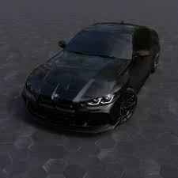
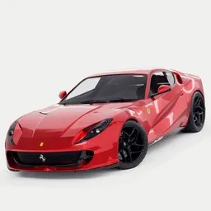
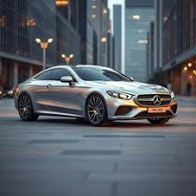
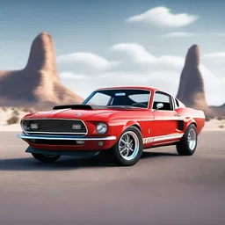
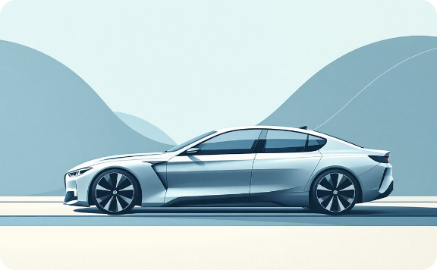


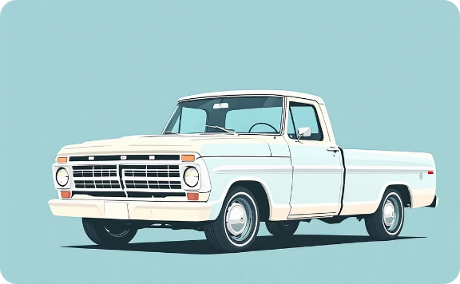
Explore Premium Brands
Explore our accurately selected range of premium automotive brands, each symbolising the summit of engineering mastery and design refinement.
BMW
Ferrari
Mercedes-Benz
Ford
Bayerische Motoren Werke AG. Where cutting-edge engineering fuses with persistent innovation Feel the thrill of the ultimate driving experience.
Italian mastery redefined. Where body shape, velocity, and craftsmanship unite. Unrestrained automotive keenness on four wheels.
German craftsmanship at its finest: Enduring sophistication fused with innovative advancements and persistent precision
American muscle redefined: Unmatched dependability where raw power fuses with everyday realism for drivers who settle for nothing less.

Slide 7

BMW Excellence
The Ultimate Driving Experience
BMW embodies the ultimate blend of performance, luxury, and cutting-edge innovation. From the high-performance M Series to the timeless E30 heritage, every model mirrors distinctive driving brilliance and technological mastery.
Performance Engineered
Technology & Safety
Turbocharged engines delivering an striking 250–300+ horsepower
0–100 kph speed attained in just 5.5–6.5 seconds
Electronically topped top speeds potential of 250 kph
Innovative torque management for optimal control and performance
Improved stability control and advanced driver assistance systems
Complete different places of airbag protection
Futuristic cruise control with lane-keeping support
Automatic emergency braking with dull detection

Slide 8
Performance Metrics: Displaying Car Data
Model
Horsepower
0-100 kph
Price
M5 Competition
~250-300 hp
5.5-6.5 sec
$200,000
M2 Competition
~250-300 hp
5.5-6.5 sec
$175,000
E30 Classic
~250-300 hp
5.5-6.5 sec
$75,000
M8 Cruise
~250-300 hp
5.5-6.5 sec
$65,000
Tables current detailed car specifications with clarity and precision. Applying proper cell padding and responsive column widths ensures finest readability on any device.

Slide 9
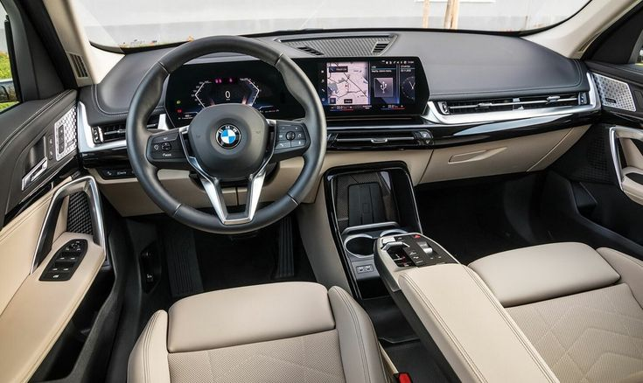
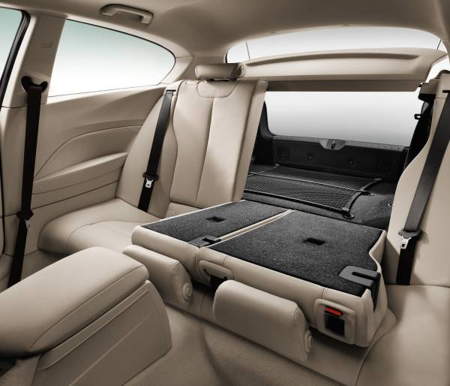
Safety & Specifications: Detailed Car Data
Safety Features
Driving Modes
Enhanced chassis design featuring crumple zones for better-quality crash absorption inhabitant and improved occupant protection.
Advanced multi-stage airbag positioning including front, side, curtain, and knee airbags to ease impact forces.
Integrated Dynamic Stability Control (DSC) and Dynamic Traction Control (DTC) for superior handling and traction in various driving conditon
Real-time tyre pressure monitoring coupled with parking sensors to alert drivers to potential issues and help with close-quarters.
Rear-view camera equipped with parking assistance technology for easier reversing and obstacle detection.
ECO PRO: Maximized competence for economical driving
COMFORT: Composed setup
for relaxed everyday journeys
SPORT/SPORT+: Enhanced
dynamics for appealing
performance
ADAPTIVE: Vigorously adjusts to
your driving style and conditions
M/TRACK: Ultimate outline for
peak track performance

Slide 10
Design Excellence: Interior & Exterior
Exterior Designs
Premium Interiors
Featuring BMW’s iconic kidney grille, blade -sharp LED/Laser headlamps, a low and wide performance carriage, smooth coupe roof curve, twin exhaust finishers, and a refined yet vibrant outline
A driver-centric cockpit featuring luxurious leather material , advanced aluminium trim, optional carbon-fibre detailing, spontaneous control layouts, and a balance of sporty character with daily comfort

Slide 11

Ferrari Passion
Raw Speed and Italian Soul
Ferrari stands as the final expression of automotive desire. From the iconic Enzo to the futuristic F80, every model reflects generations of racing legacy and persistent performance invention.
Enzo Ferrari
$750,000 - A masterpiece of advanced engineering and pure speed
LaFerrari
$500,000 - A seamless blend of hybrid innovation and iconic performance
Ferrari F40
$450,000 - The final symbol of clean performance
Ferrari F80
$550,000 - Next-generation supercar brilliance , price

Slide 12
The Ferrari Comparisons
Models
Laferrari
Enzo
F40
Engines
V12 Hybrid
V12 N/A
V8 Twin-Turbo
Horsepower
Hp - 950
Hp - 650
478 hp
Km\h(0-100)
2.8s
3.65s
3.8s
Maximum speed
380km\h
350km\h
324 km/h
Units built
500
400
1,311
Car price
$1.4M
$600-750K
$450K

Slide 13
Your Ferrari Journey Await For You
Discover our full lineup of legendary models. Every vehicle symbolises a exclusive chapter in Ferrari's storied history, showing the brand's change while upholding its firm commitment to unmatched performance and superiority
LaFerrari
Enzo Ferrari
Hybrid Hypercar : Fineness in Hybrid Innovation
Mid-Engine Masterpiece: Accuracy Engineering at Its Peak
Ferrari F40
Ferrari F80
Twin-Turbo Legend: Discharging Supreme Power
The Forthcoming Performance: Redefining velocity, Invention

Slide 14
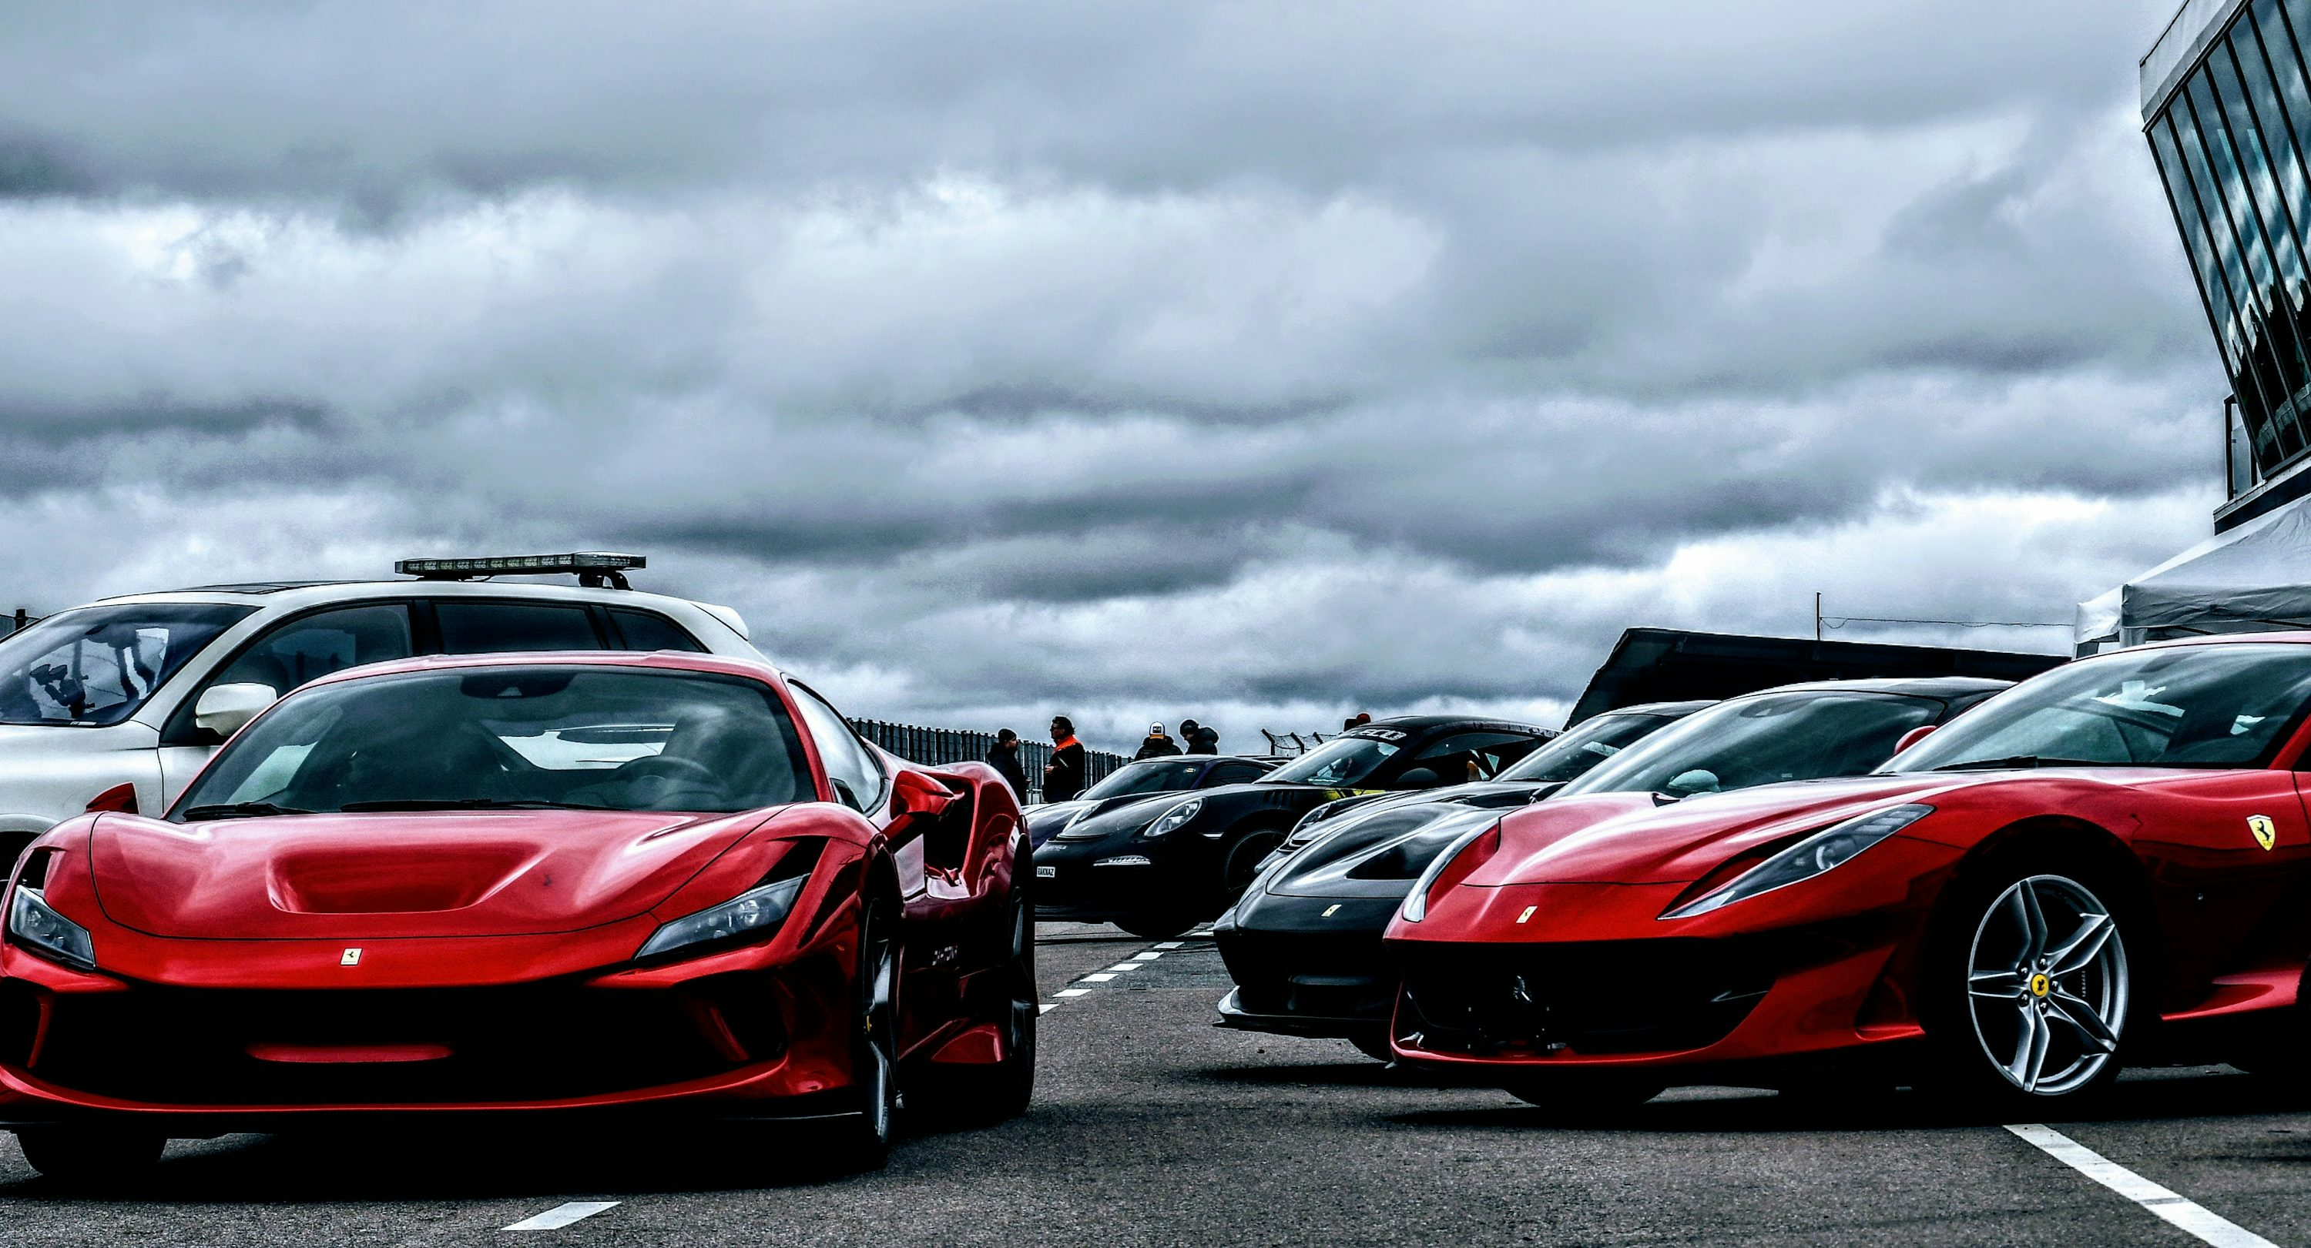
Your Ferrari Adventure Starts Here
Whether you're launching your first fan site or extending your passion for these iconic machines, Ferrari represents the perfect blend of speed, grace, and automotive craftsmanship , thanks for joining us on this exciting journey through the world of Ferrari
Overpoweringly Crafted for Ferrari Devotees and aspiring Web Designers Worldwide.

Slide 15
Mercedes-Benz Amg
Luxury Refined, Performance Enhanced
Mercedes-Benz engineer that seamlessly blend luxury with cutting-edge precision , From the rough dominance of the G-Wagon to the refined grace of the S-Class, every model offers unmatched elegance and versatility.
Iconic Models
G- Wagon ($350,000) : Legendary off-road power meets the elegance.
Maybach ($450,000): Expression of Ultimate comfort and luxury fell
S-Class ($95,000+): Luxury Sedans Benchmark Worldwide
SLR ($85,000): Timeless Elegance Wrapped in Thrilled performance

Slide 16
Our Mercedes Collection
Mercedes-Benz spans from challenging off-road vehicles to elegant luxury sedans, ensuring excellent quality in every category. Every model reflects a heritage of engineering brilliance and design superiority.
G - wagon
Maybach
Legendary Off-Road Icon: Unmatched Ability and Dominant Manifestation.
Ultimate Luxury Expression: Modified Craftsmanship Meets Best Comfort.
S-class
CLE
Top Sedan: Merging High-Octane Performance with Advanced Everyday Elegance.
Modern Elegance: Athletic Styling Meets Adaptable Practicality.

Slide 17








Premium Features In All Models
Safety First
Safety First
Driving Dynamics
Unconventional multi-stage airbags, electronic stability control, and analytical collision warning systems safeguard you at every turn.
Adaptive suspension, accuracy in steering control , and responsive treatment deliver confidence whether cruising highways or exploring terrain
Digital innovation
Interior Comfort
Advanced documentary systems, smartphone integration, and automatic parking technology re define suitability and connectivity
Hand-stitched leather, ambient lighting, climate control, and bird's-eye sunroofs create reservation from the outside world

Slide 18

Ford Strength
Reliability and American Power
Ford engineers that made vehicles to deliver uncompromising performance and genuine driving excitement. Drawing from its legendary Mustang heritage, Ford flawlessly blends modern capability with everyday practicality
$200K+
$75K
$200K+
$75K
$112K
$112K
Ford Fiesta
Ford Mustang
Ford Bronco
Everyday practically and Nimble performance
Turbo Charged Performance With American Muscles
Modern adventure with rugged compatibility
$165K
$165K
Ford Taurus
Advanced Design completing With Performance

Slide 19
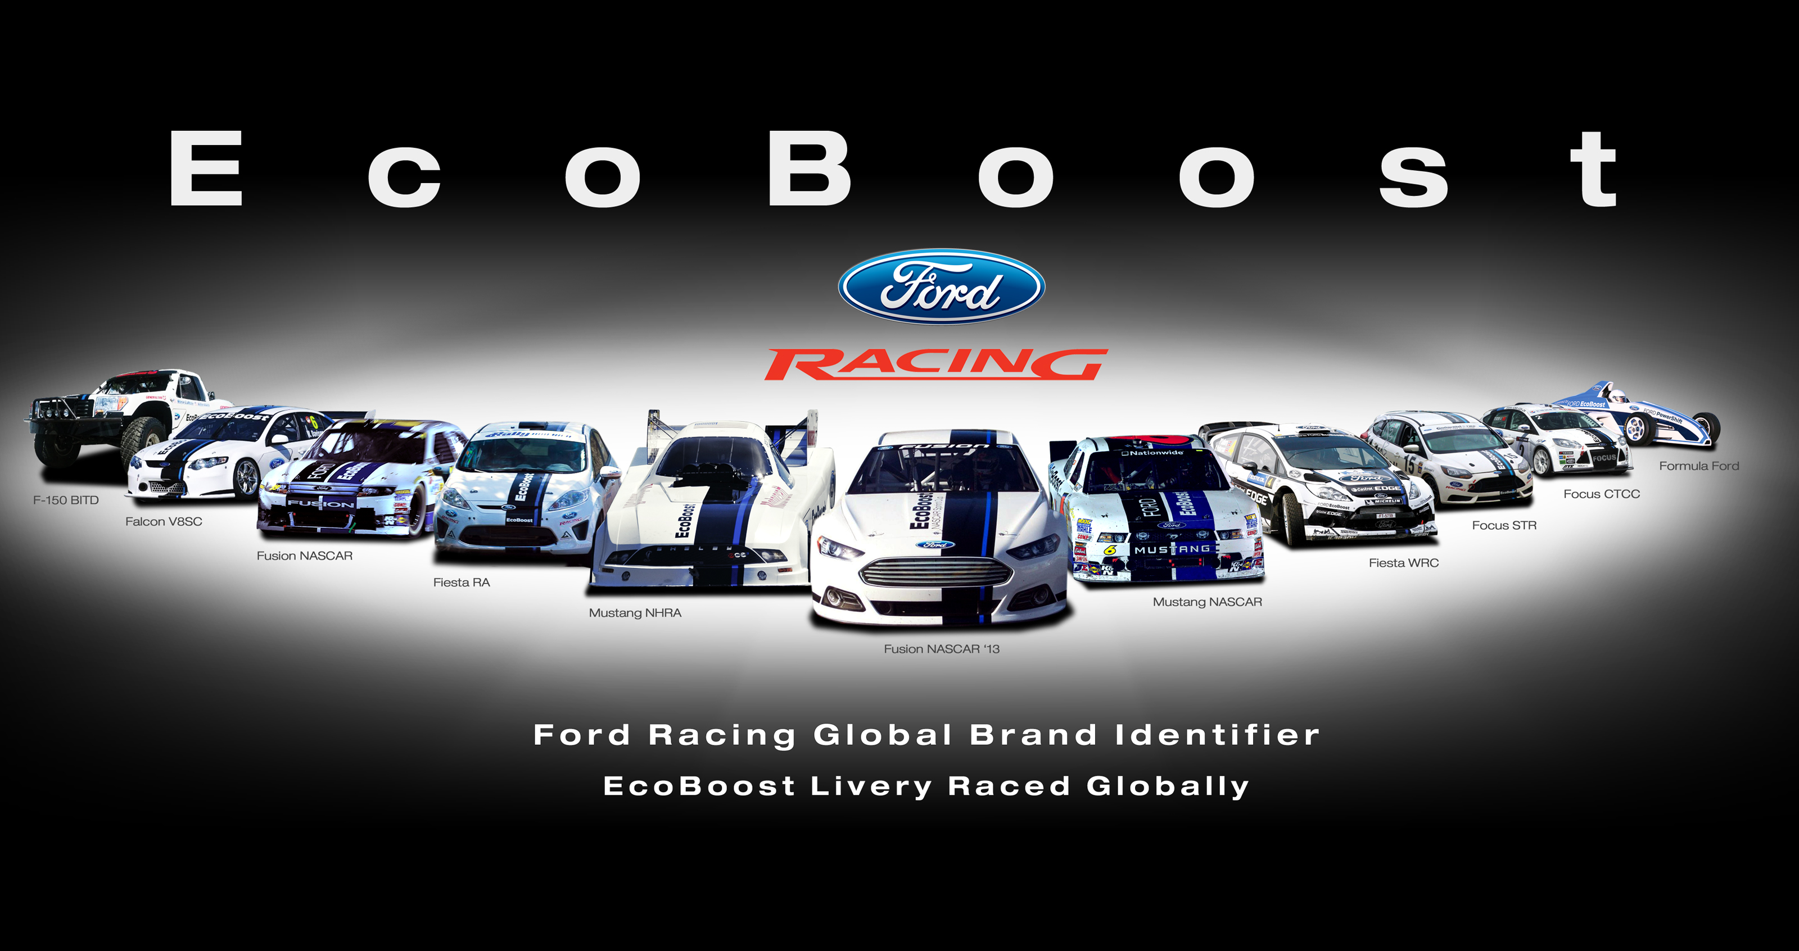
Ford Model Line Up
Mustang
Bronco
This iconic performance coupe delivers the excitement of its legendary turbocharged power
This premium SUV seamlessly blends rough adventure capability with cultured luxury refinement
Fiesta
Taurus
A forceful compact car that proves efficiency doesn't have to be boring, offering openly dynamic handling for every transform.
The versatile sedan that defines smart value, expertly combining affordability with all the essential features you need

Slide 20




Safety Across All Modles
Ford ensures your safety is vital, building every vehicle with a combination of strong construction and innovative, state-of-the-art safety technology
Passive Safety
Protection System
Advanced protection is built in, featuring a strengthened steel body, strategically designed crumble zones, and complete side-impact protection systems to shield
A complete safety suit including front, side, curtain, and knee airbags—operates effortlessly with stability control and dynamic traction systems for all-around protection
Advanced Safety
Advanced Safety
Driver Assistance
Advanced driver assistance features including Adaptive Cruise Control, Lane Departure Warning, Blind Spot Detection, and Emergency Automatic Braking make every journey safer and less stressful
Clarity and confidence come standard: Rear-view cameras, 360-degree parking sensors, and advanced monitoring systems work together to gives , you total awareness of your surroundings

Slide 21

Your Perfect Ford Awaits
Performance Enthusiasts
Experience the legend: The Mustang delivers a rush of extreme speed, head-turning aggressive styling, the unmatched feeling of pure driving excitement
Adventure Seekers
The Bronco offers a rare division, effortlessly integrating premium comfort and luxury features with inflexible, genuine off-road capability
Efficient Drivers
The Fiesta delivers a dynamic blend of exciting, responsive performance and smart fuel-conscious driving modes, all controlled by quick agile handling
Practical Families
The Taurus is your smart choice for the road, providing steady reliable transportation, unbending essential safety, and the peace of mind that comes with excellent value
Stop by your local Ford dealership now and see the revolution, reliability, and craftsmanship that set the standard for American automotive excellence

Slide 22
Vehicle Features & Performance
For the sharp driver, every model we offer is equipped with advanced technology, complete safety systems, and the performance capabilities you demand
Performance
230-250 kph top speed ,5.5-6.5s 0-100 kph, 250-300+ hp,
Safety Features
Advanced Safety controls, Multi Stage Airbags, Full Quality of Suspension
Technology- Drivers
emergency braking ,Adaptive cruise , blind spot detection, lane departure warning
Modes of Driving
Track optimized for every condition, Sport, Adaptive, Eco Pro, Comfort
Design Excellence
aluminum trim, signature lighting, Premium leather, carbon fiber accents

Slide 23

Drive your Dream
Elite Auto Gallery is where your journey begins. We transform automotive ambitions into reality, that goes far beyond simply selling cars
Personalized consolation
Curated Selection
Our experts provide personalized guidance and adapted advice to ensure you find the perfect vehicle that truly matches with your lifestyle and unique preferences
Find our exclusive inventory of the finest luxury and performance vehicles, each one precisely inspected to guarantee the highest quality
Seamless Acquisition
Dedicated After- Sales
Experience the ease of a truly bother free purchasing journey, complete with flexible financing options and effortless, efficient certification and delivery
Our dedication extends well beyond the sale. Trust on our complete after sales service and support to ensure your complete peace of mind throughout your ownership

Slide 24
THANK YOU

